Slide 1
Game Planet (Game of the Year)
GROUP 4
Hua Shi lei abalos
John kimmer
Khadley wong
Bea Galvez
Viola belardo

Slide 2
INTRODUCTION
Every year, the most popular games change, and players are kept up to speed on the best games to play right now. A website called Game Planet offers details on the top 10 video games of the current year, 2022.

Slide 3
OBJECTIVES
Identifying the top games by presenting a list of games and their ratings at the end of the year is the first goal of this information system. Second, to entice a player to play the game, describe and clarify the set of rules. Third, gather feedback that will set the game apart from other common games as the best one played. Finally, describe each game's objective to encourage players to participate in the best games of the year.

Slide 4
SCOPE
Games became viral and were updated for every generation; they are incredibly special to the youths of today. Those not yet familiar with games are also the ones we will prioritize in conducting this study. It will be introduced and listed as one of the top 2022 games. The most recent versions of games that will excite the youth will correspond to their interests. Our target for this study is the "children" who play the old-fashioned way or have zero interest in playing the games. Some games are online learning games that can educate the mental faculties of children.

Slide 5
LIMITATIONS
Children's games are not fit for adults anymore unless they can also watch and learn with their younger siblings, children, and those who are below the ten years and are not familiar with games. Adults teach younger children to play because they have more experience. Too many games on gadgets at an early age can cause eye strain. Be aware and limit your time when playing games. Otherwise, they will use eyeglasses.

Slide 6
PROJECT DESCRIPTION
This project was created to keep users and those who are just starting out in the gaming world up to date on what's new and what games they should buy. We also provide the needed information for each game we list, including their genre, platform, game type, and everything you need to know about a certain game.

Slide 7
SUMMARY AND CONCLUSION
To put it simply, Game Planet acts as a showcase for games that are popular all year long and allows gamers to see which titles are still in circulation and receiving the hype.

Slide 8
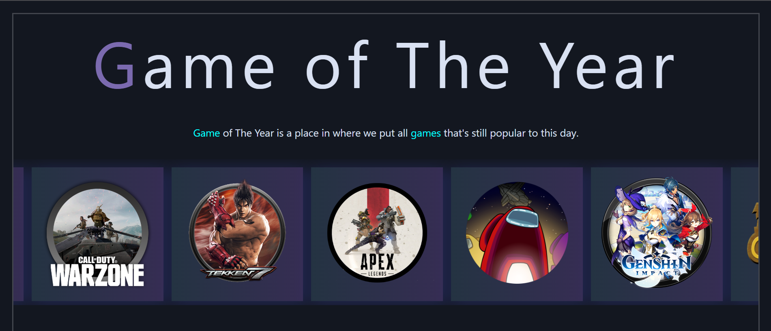
HEADER

Slide 9

Navigation

Slide 10
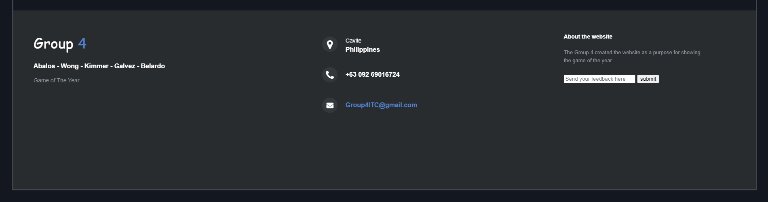
Footer

Slide 11
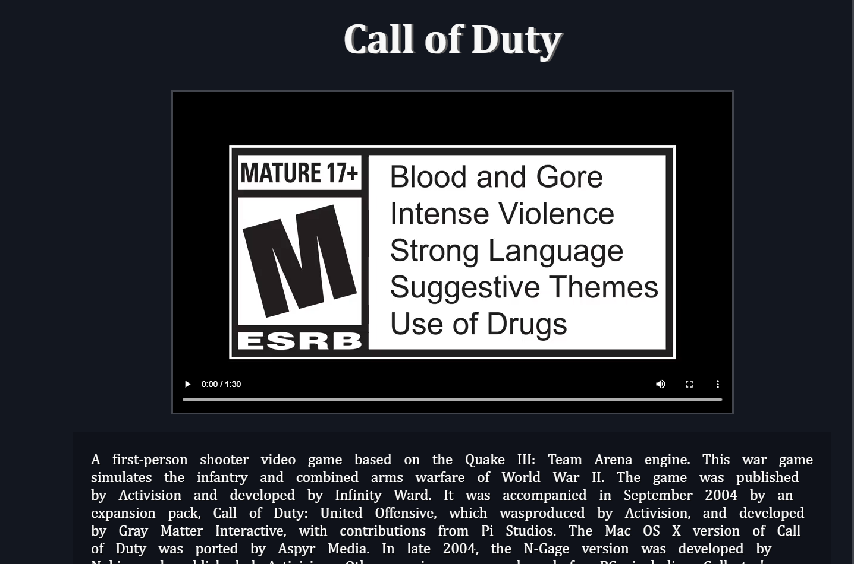
Section/Aside

